Slide 1
Chapter 2
Matrices
Matrices provide an orderly way of arranging values or functions to enhance the analysis of systems in a systematic manner. Their use is very important in simplifying large arrays of equations and in determining their solutions. In particular, computer algorithms for manipulating large arrays are simplified greatly by matrix notation and operations.

Slide 2
A particular reason for introducing matrices at this point is that MATLAB is heavily matrix oriented. One does not have to be an expert in matrix theory to utilize the powerful features of MATLAB, but it is very helpful to understand some of the terminology and manipulations. This chapter will deal with those basic elements of matrix theory that can be used for that purpose. The term linear algebra is often used to represent the general theory of matrices and the associated algebraic operations.

Slide 3
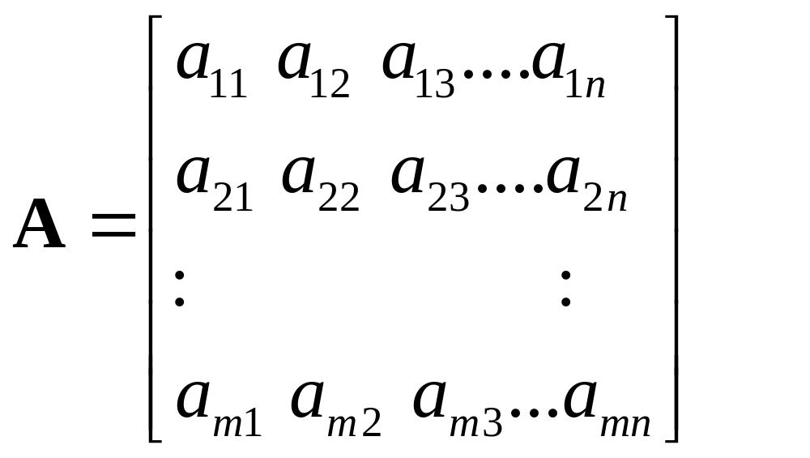
General Form of a Matrix of Size m x n with m Rows and n Columns

Slide 4

Square Matrix
If m = n, the matrix is said to be square. In this case, the matrix could be designated as an m x m matrix.

Slide 5
Vectors
A matrix having only one row is called a row matrix. A matrix having only one column is called a column matrix. A matrix of either form is called a vector. The row matrix is called a row vector and the column matrix is called a column vector.

Slide 6
Scalars
A 1 x 1 matrix is called a scalar and is the form of most variables considered in simple algebraic forms.

Slide 7
Transpose
The transpose of a matrix A is denoted as A’ and is obtained by interchanging the rows and columns. Thus, if A has a size of m x n, A’ will have a size of n x m. If the transpose operation is applied twice, the original matrix is restored.

Slide 8
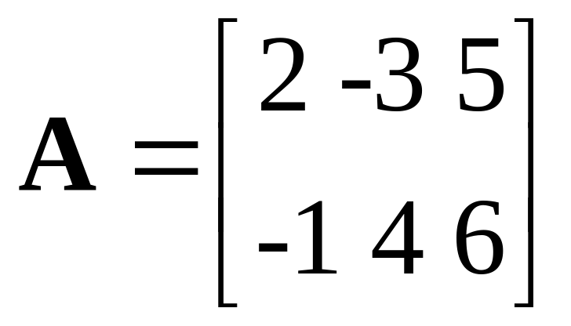
Example 2-1. Determine the size of the matrix shown below.
The matrix has 2 rows and 3 columns. Its size is 2 x 3.

Slide 9
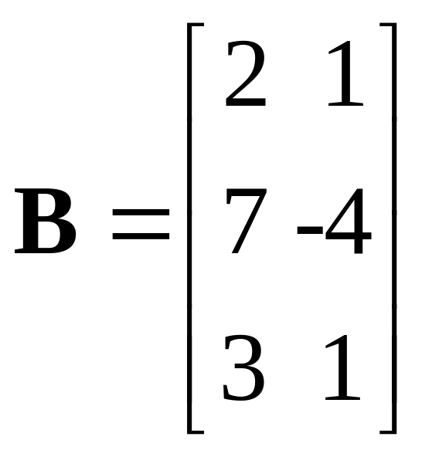
Example 2-2. Determine the size of the matrix shown below.
The matrix has 3 rows and 2 columns. Its size is 3 x 2.

Slide 10
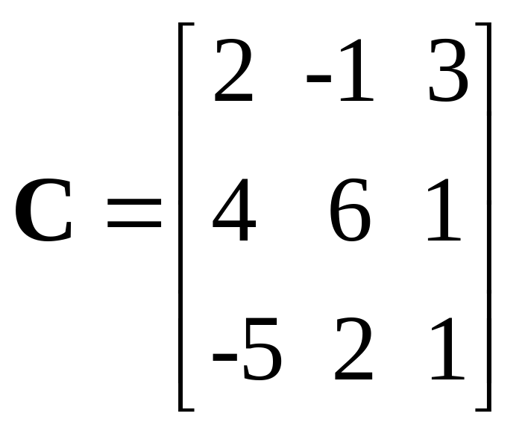
Example 2-3. Determine the size of the matrix shown below.
The matrix has 3 rows and 3 columns. Its size is 3 x 3. It is a square matrix.

Slide 11
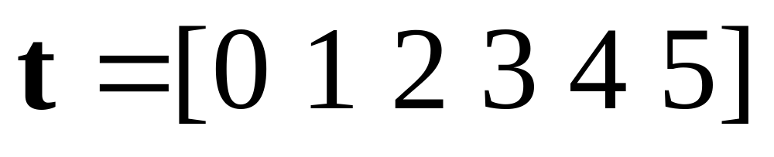
Example 2-4. Express the integer values of time from 0 to 5 s as a row vector.
The size of the vector is 1 x 6.

Slide 12
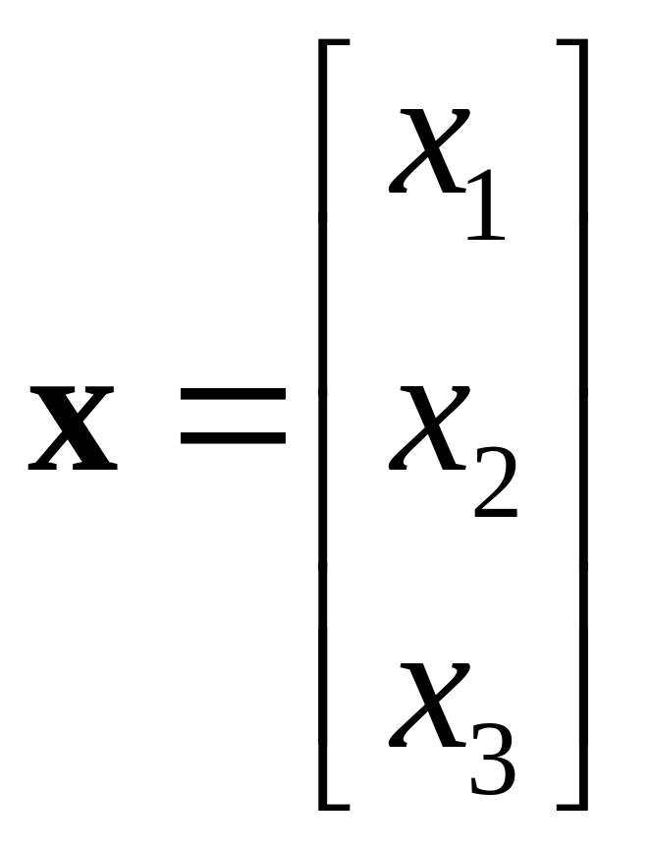
Example 2-5. Express the variables x₁, x₂, and x₃ as a column vector.

Slide 13
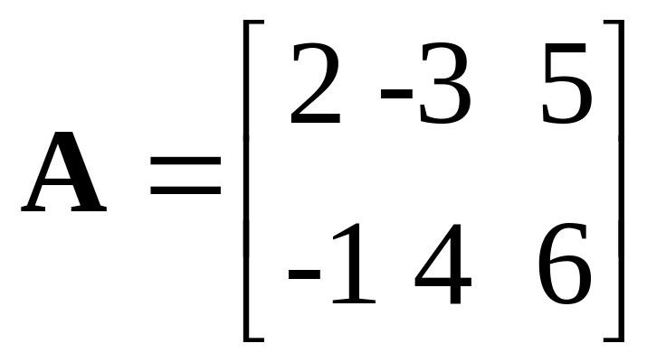
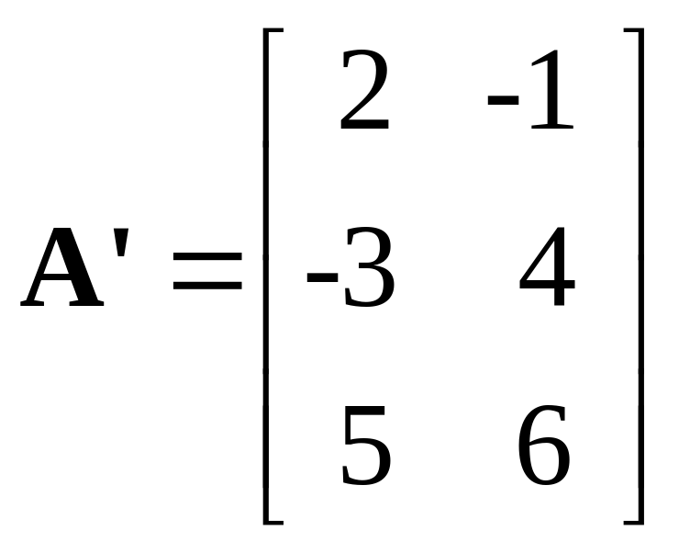
Example 2-6. Determine the transpose of the matrix A below.

Slide 14
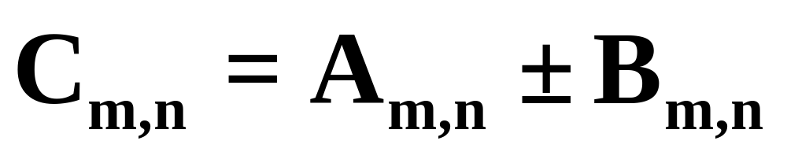
Addition and Subtraction of Matrices
Matrices can be added together or subtracted from each other if and only if they are of the same size. Corresponding elements are added or subtracted.

Slide 15

Multiplication of Two Matrices
Two matrices can be multiplied together only if the number of columns of the first matrix is equal to the number of rows of the second matrix. This means that

Slide 16
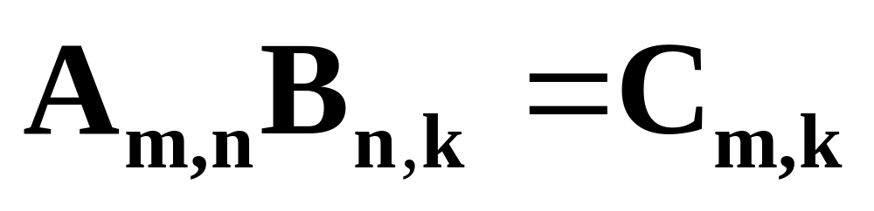
Multiplication of Two Matrices
(Continuation)
The number of rows in the product matrix is equal to the number of rows in the first matrix and the number of columns in the product matrix is equal to the number of columns in the second matrix.

Slide 17
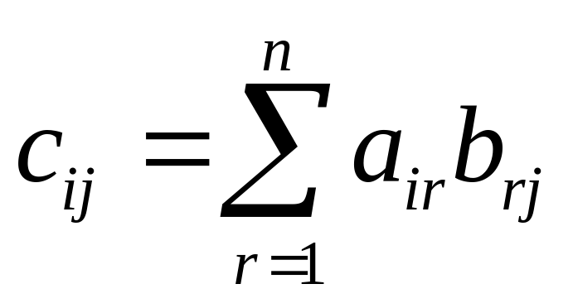
Multiplication of Two Matrices
(Continuation)
An element in the product matrix is obtained by summing successive products of elements in the row of the first with elements of the column of the second.

Slide 18
Division of Matrices ?
There is no such thing as division of matrices. However, matrix inversion can be viewed in some sense as a procedure similar to division. This process will be considered later.

Slide 19
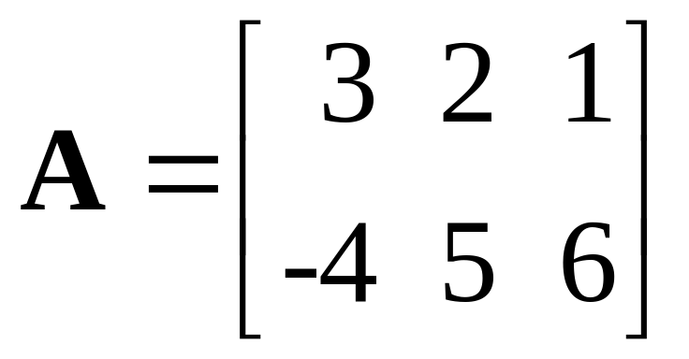
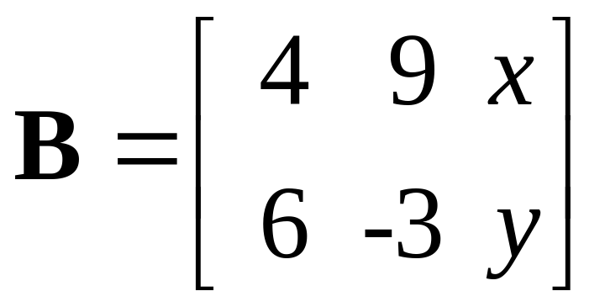
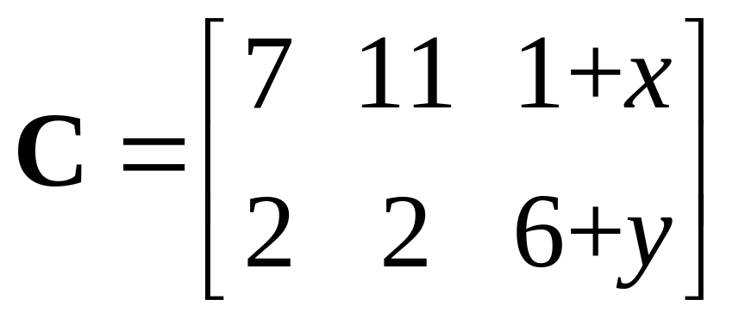
Example 2-7. Determine C = A + B for the matrices shown below.

Slide 20
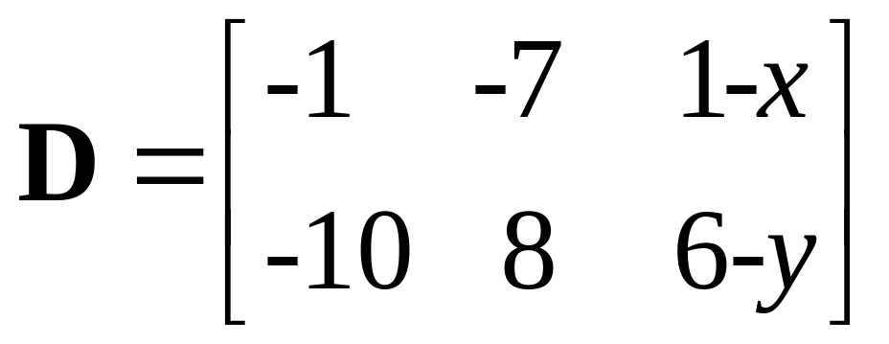
Example 2-8. Determine D = A - B for the matrices shown below.

Slide 21

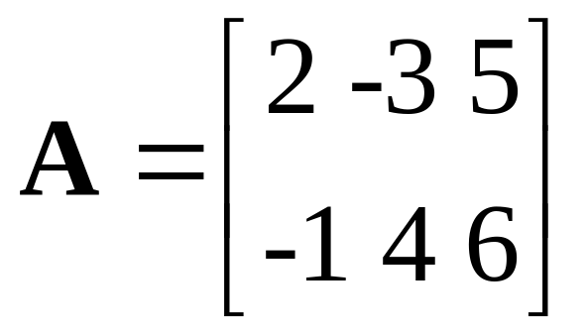
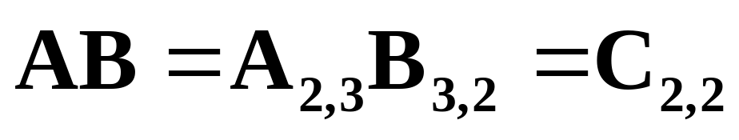
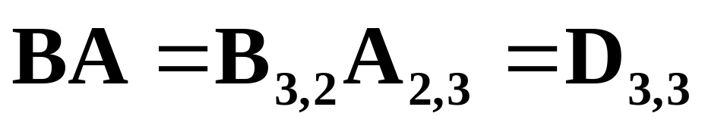
Example 2-9. For the matrices of Examples 2-1 and 2-2, determine possible orders of multiplication.

Slide 22
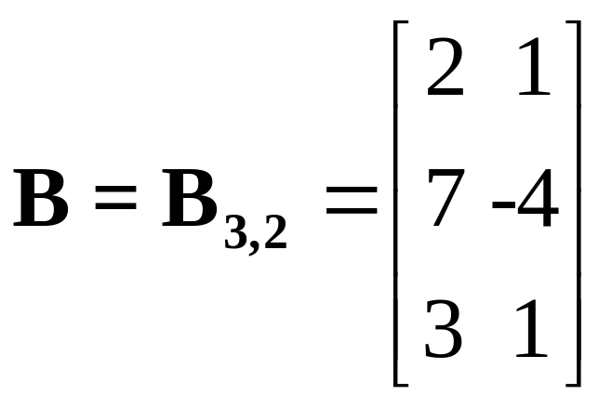
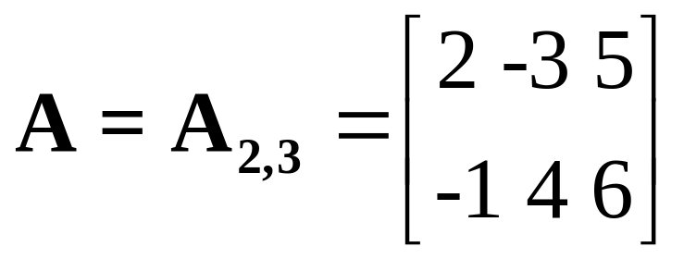
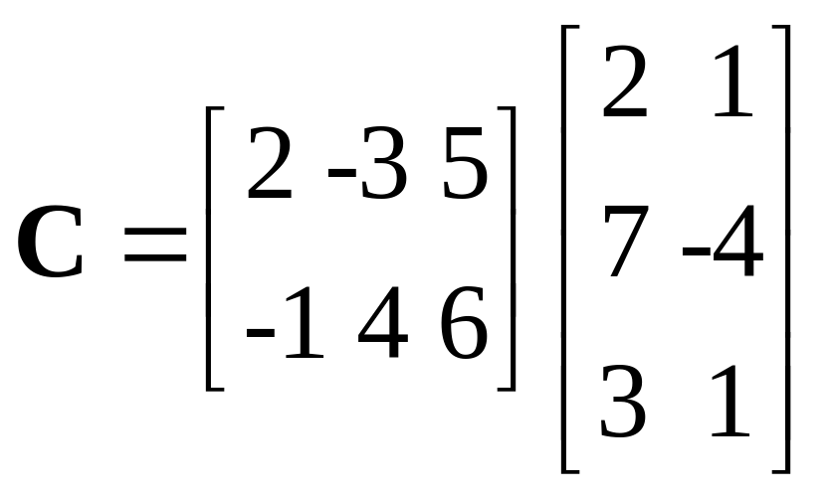
Example 2-10. For the matrices of Examples 2-1 and 2-2, determine C=AB.

Slide 23
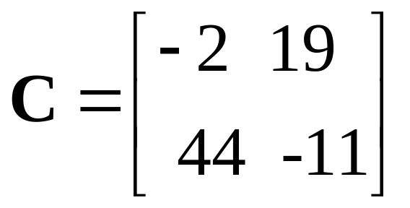
Example 2-10. Continuation.

Slide 24
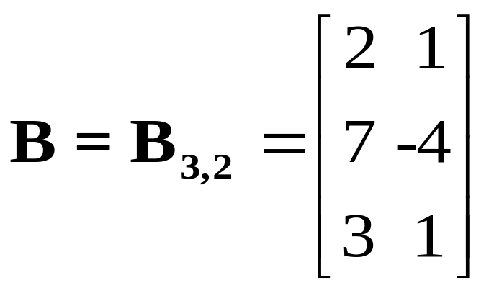
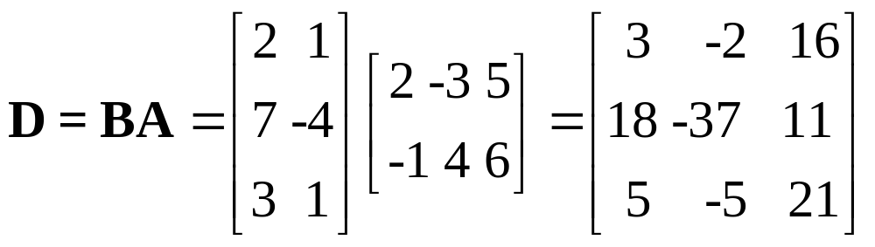
Example 2-11. For the matrices of Examples 2-1 and 2-2, determine D=BA.

Slide 25
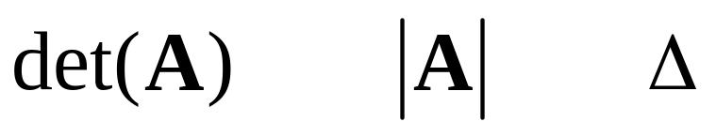
Determinants
The determinant of a matrix A can be determined only for a square matrix. It is a scalar value. Various representations are shown as follows:

Slide 26
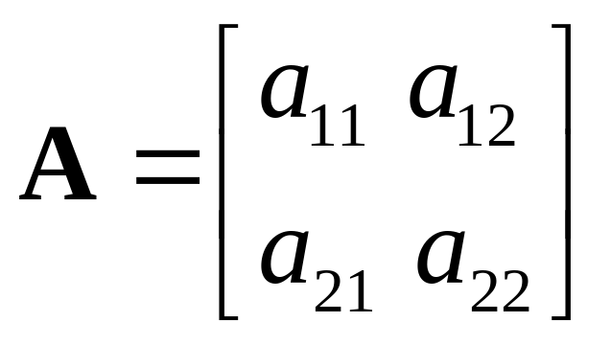
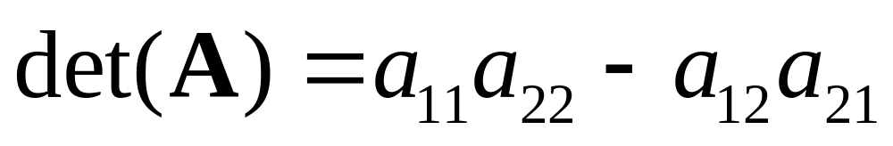
Determinant of 2 x 2 Matrix

Slide 27
Determinants of Higher-Order
For determinants of matrices of higher order than 2 x 2, the process can become tedious. There are many “tricks”, but some are useful only when the matrix has simple numbers. The text provides a procedure based on minors and cofactors, but since the ultimate goal is to use MATLAB, that procedure will not be covered on these slides. Instead, formulas for the 3 x 3 case will be provided.

Slide 28
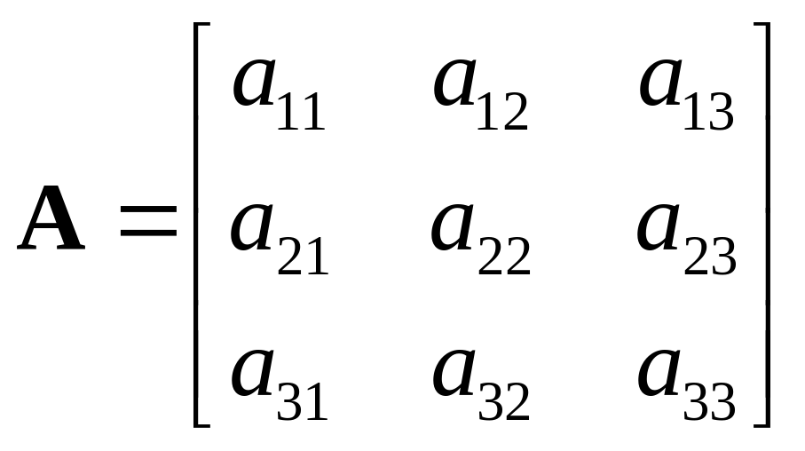
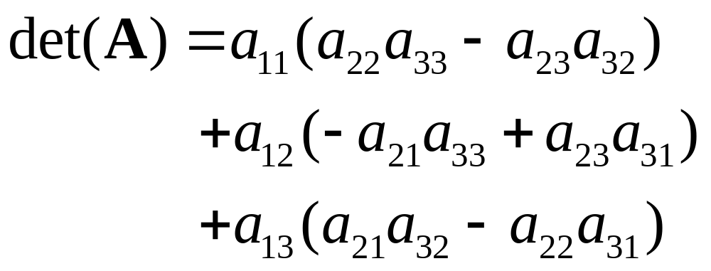
Determinant of 3 x 3 Matrix

Slide 29
Singular Matrix
If det(A)=0, the matrix is said to be singular. If the matrix represents the coefficients of a set of simultaneous equations, it means that the equations are not independent of each other and cannot be solved uniquely.

Slide 30
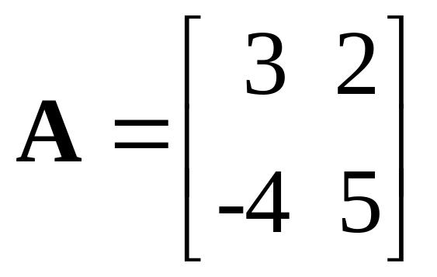
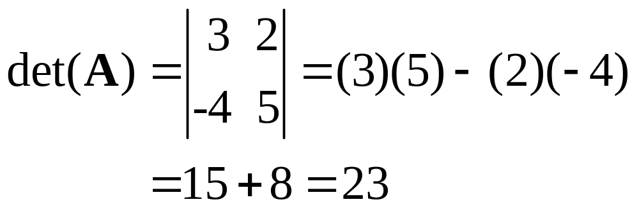
Example 2-13. Determine the determinant of the matrix shown below.

Slide 31
Examples 2-13, 2-14, and 2-15
These 3 examples involve computations concerning the minors and cofactors of a 3 x 3 matrix and will not covered in this presentation. The results that follow these computations will be considered in a later example.

Slide 32
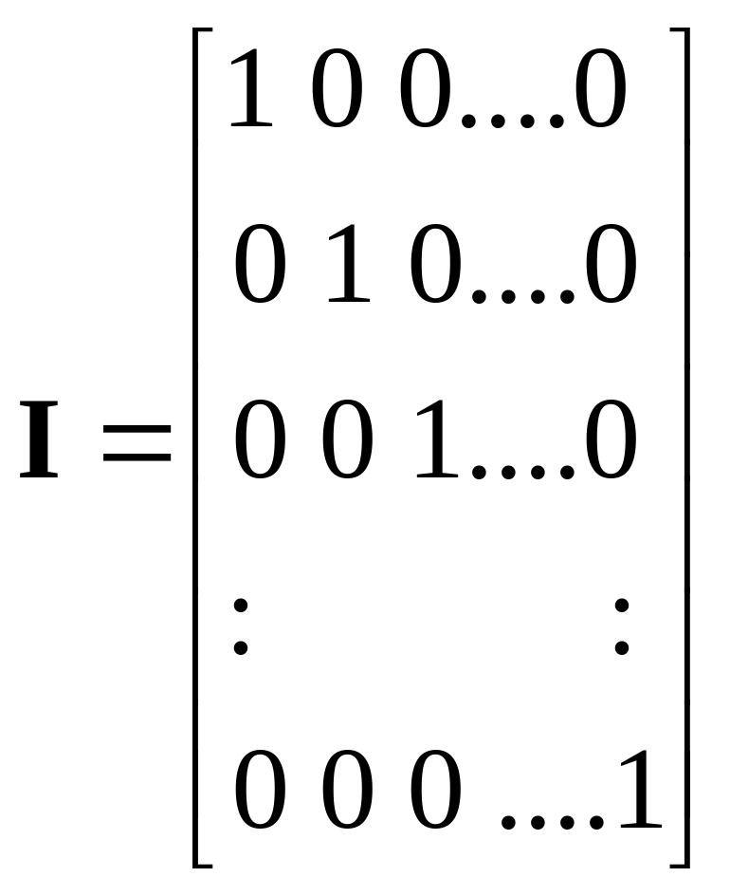
Identity Matrix

Slide 33
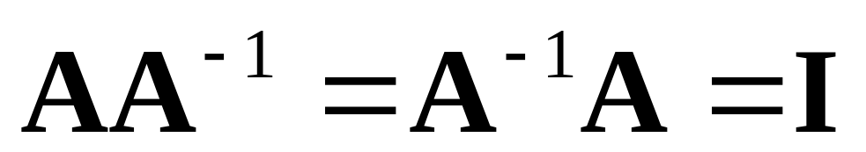
Inverse Matrix
The inverse of a matrix A is denoted by A⁻¹ and is defined by the equation that follows.

Slide 34
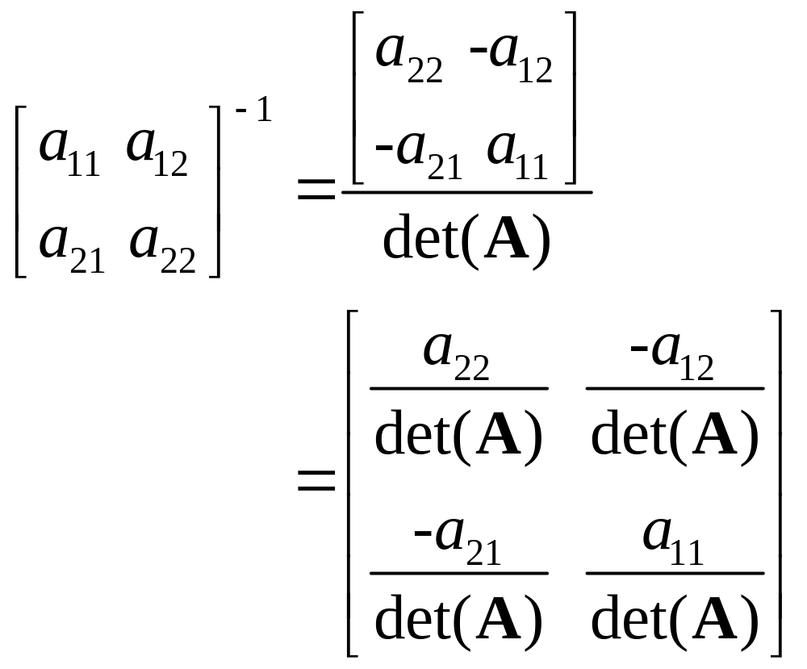
Inverse of a 2 x 2 Matrix

Slide 35
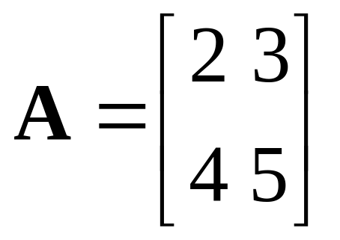
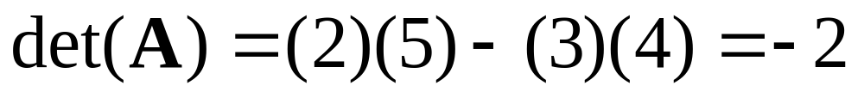
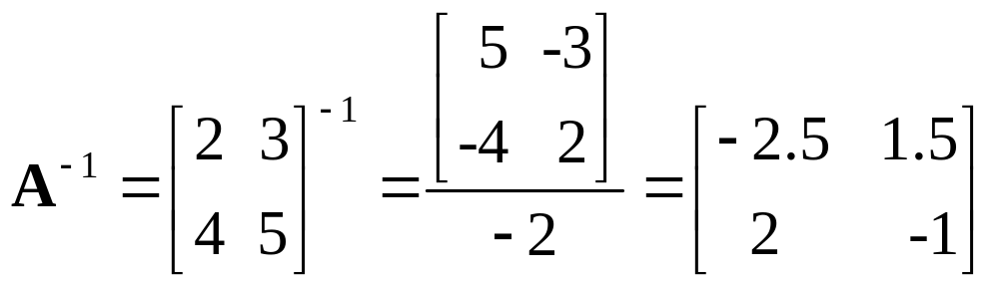
Example 2-16. Determine the inverse of the matrix A below.

Slide 36
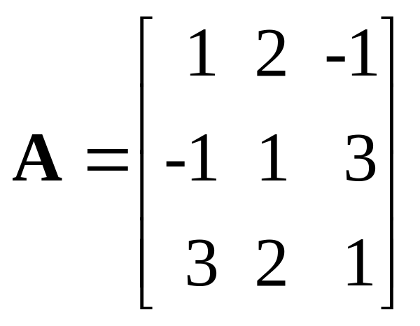
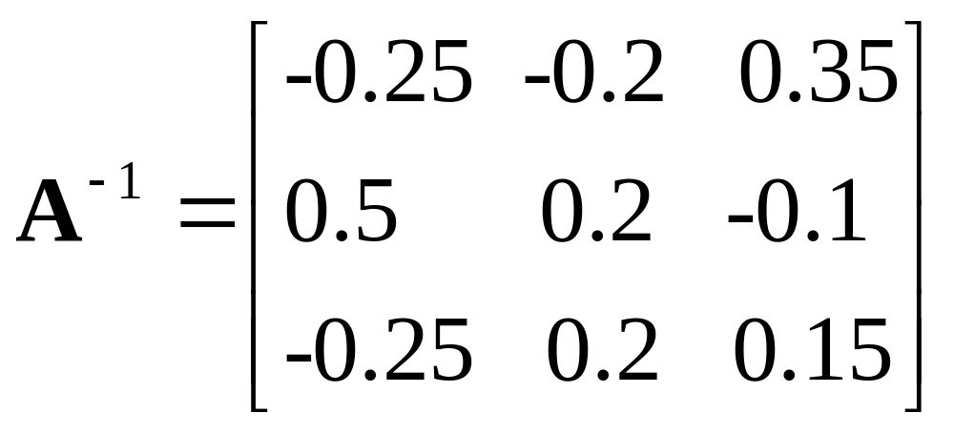
Example 2-17. The inverse of A below is developed in the text.

Slide 37
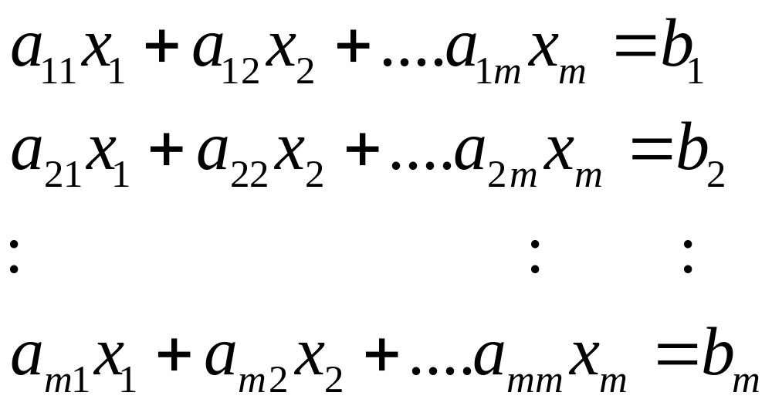
Simultaneous Linear Equations

Slide 38
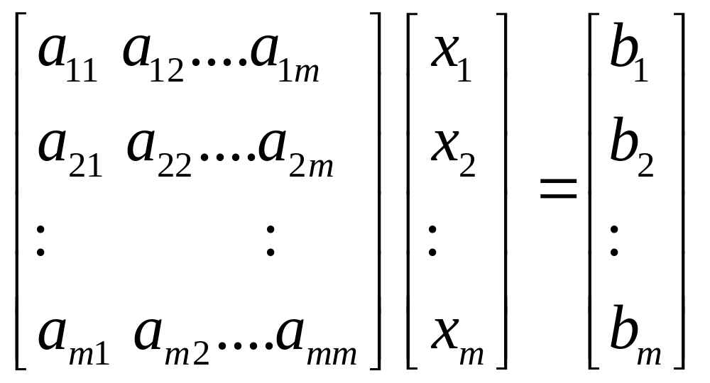
Matrix Form of Simultaneous
Linear Equations

Slide 39
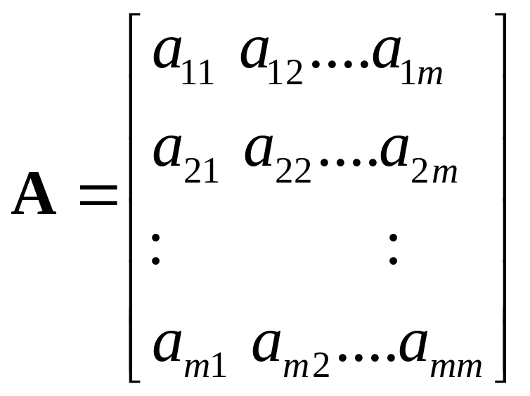
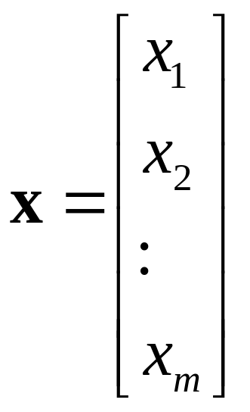
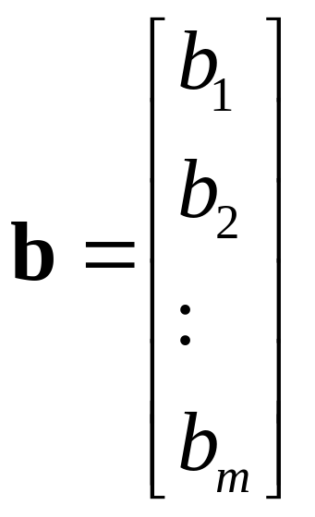
Define variables as follows:

Slide 40
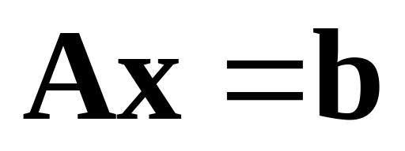
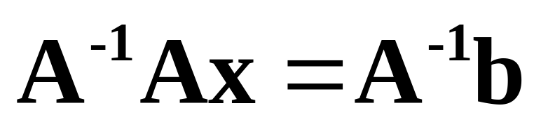
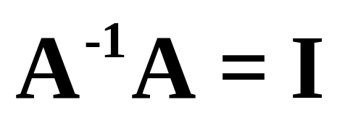
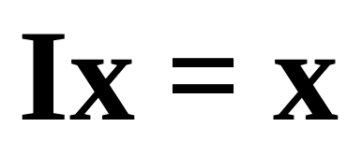
Matrix Solution Development

Slide 41
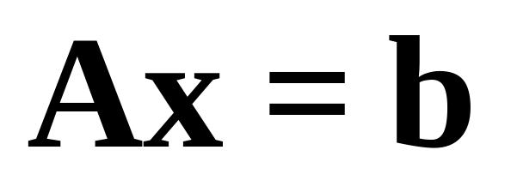
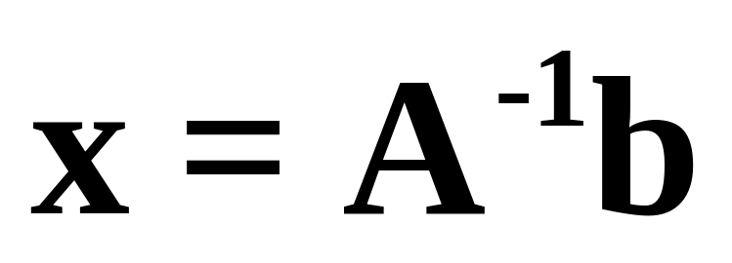
The general form and the final solution follow.

Slide 42



Example 2-18. Use matrices to solve the simultaneous equations below.

Slide 43


Example 2-18. Continuation.

Slide 44


Example 2-18. Continuation.

Slide 45




Transformation of Linear Variables

Slide 46




Transformation Continuation

Slide 47


Transformation Continuation

Slide 48




Example 2-19. For the system of equations provided below, determine the z values in terms of the x values.

Slide 49


Example 2-19. Continuation.

Slide 50


Example 2-19. Continuation.

